Slide 1
M-KNOW
INF354
15120822 Ehi Okharedia
15380743 Joyce Mande
15282687 Geoffrey Okochil
16302606 Travis Simelane
15128271 Itumeleng Morei

Slide 2
About M-Know
M-Know is a mobile application that was created to address Malaria and educate users about the disease, help users from regions affected by your chosen disease to understand, prevent, monitor, recognize, treat, and/or control the disease

Slide 3
M-Know functionality
Information about Malaria
Malaria causes
Malaria symptoms
Malaria treatment
Malaria Prevention
Frequently asked questions

Slide 4
M-KNOW Functionality
Malaria risk zones (include a map)
Medical practitioners
Newsletters and statistics
Helpline

Slide 5
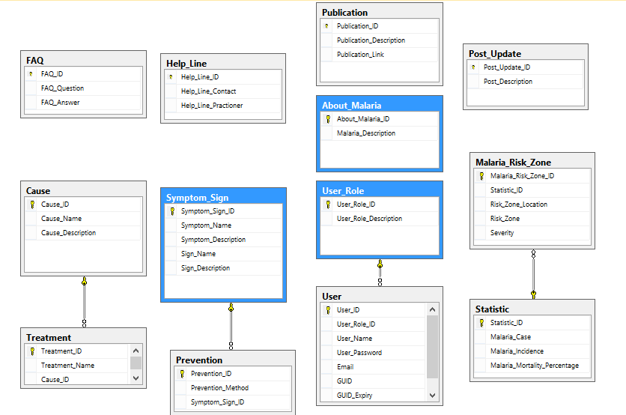
The database diagram
The database diagram shows the
different tables and how they are linked.

Slide 6
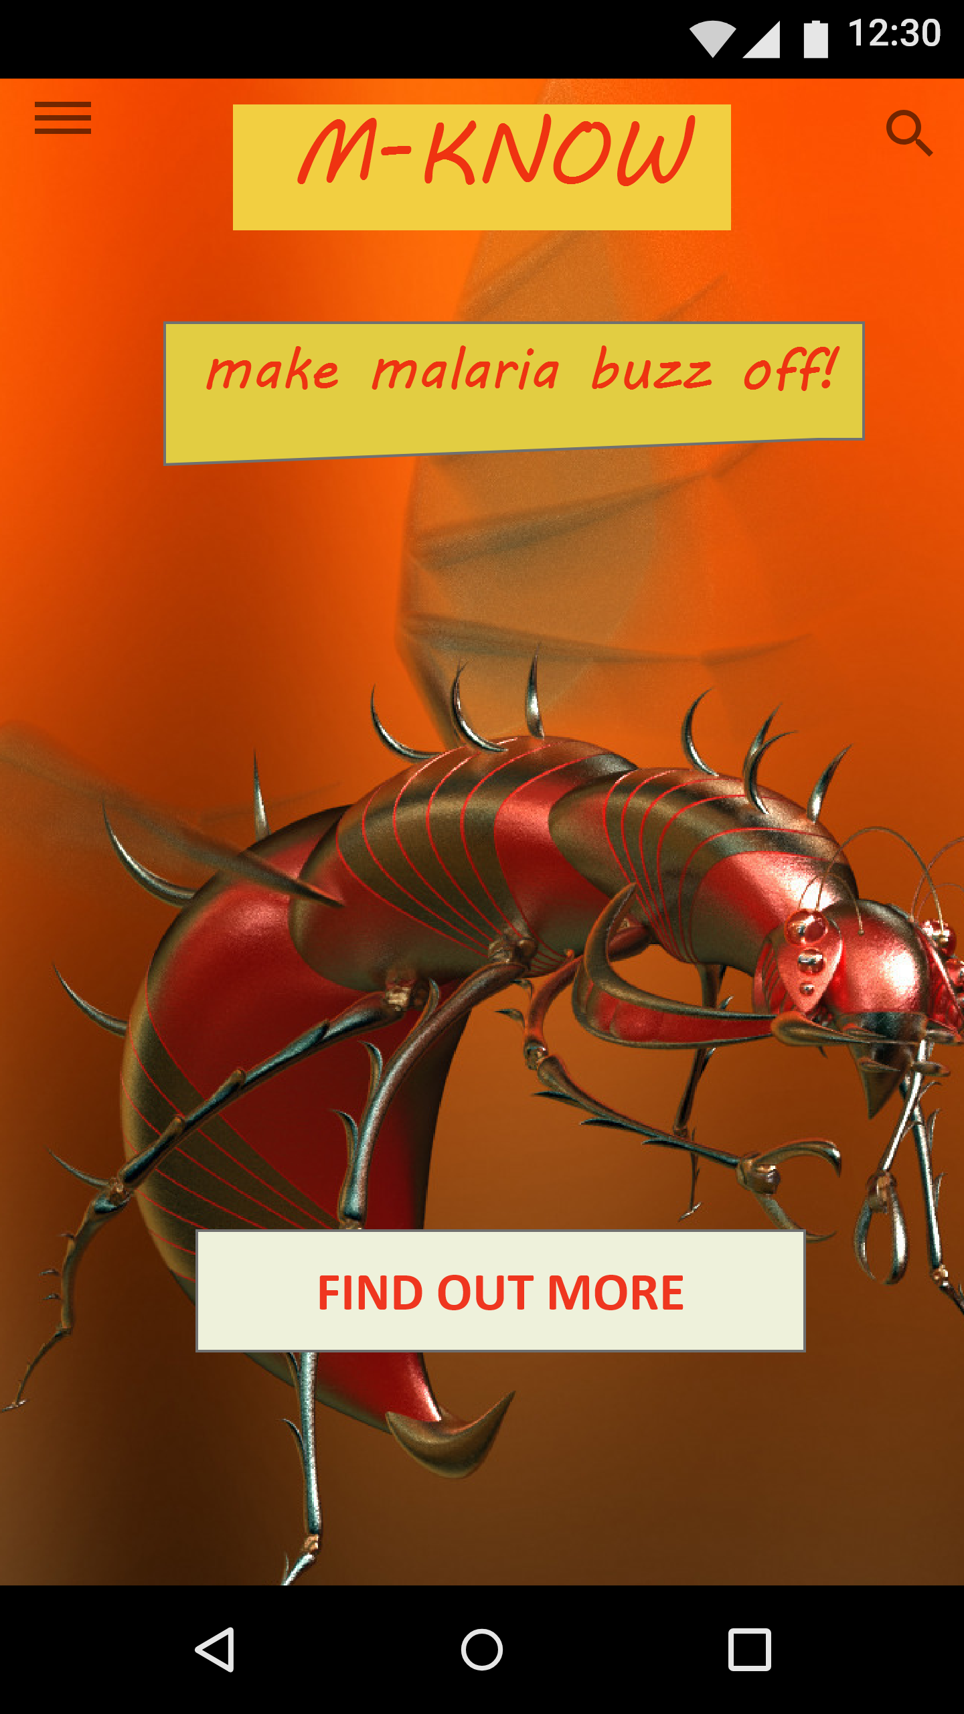
M-Know Home Page - Mobile App
Menu option
Home page is used to welcome the user and the menu option is there to navigate through the mobile application

Slide 7
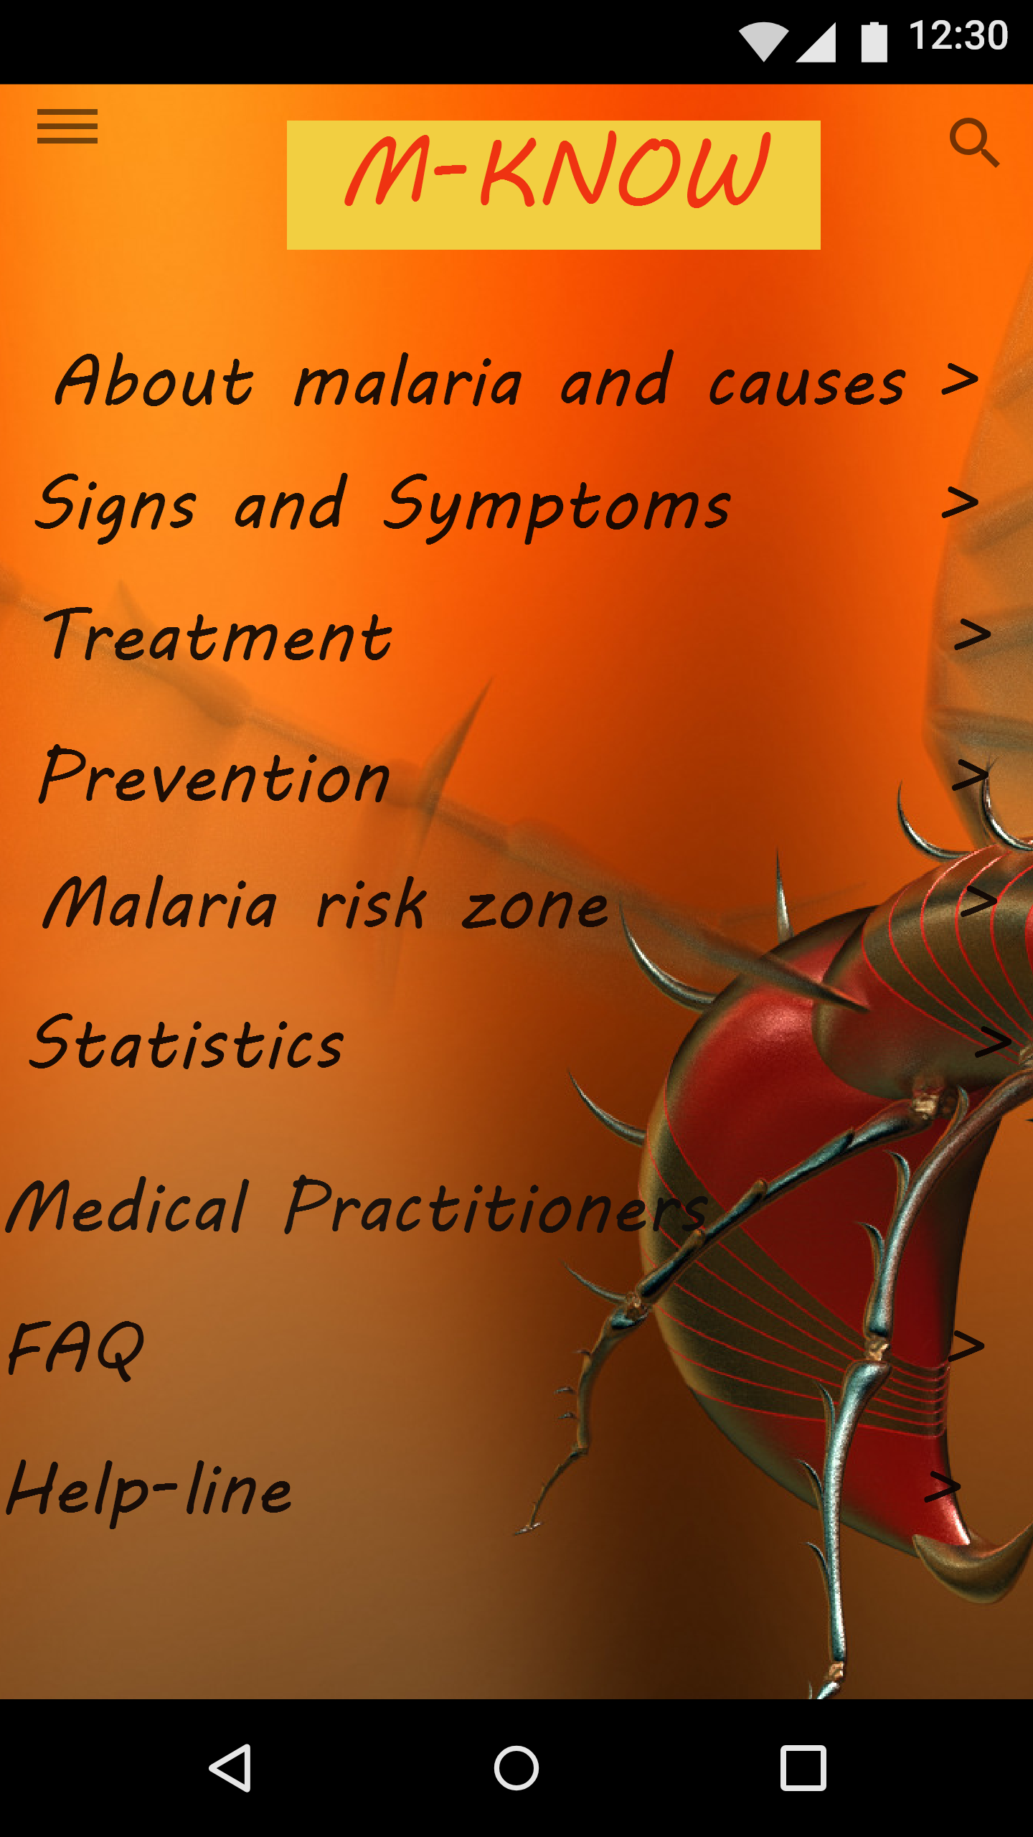
M-Know Navigation Menu
The navigation menu shows the pages that you find on the mobile application.

Slide 8
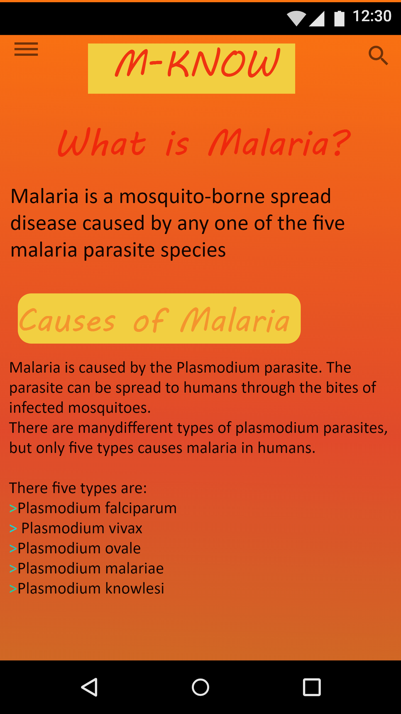
M-Know About malaria and causes
The screen shows information about malaria
and the causes

Slide 9
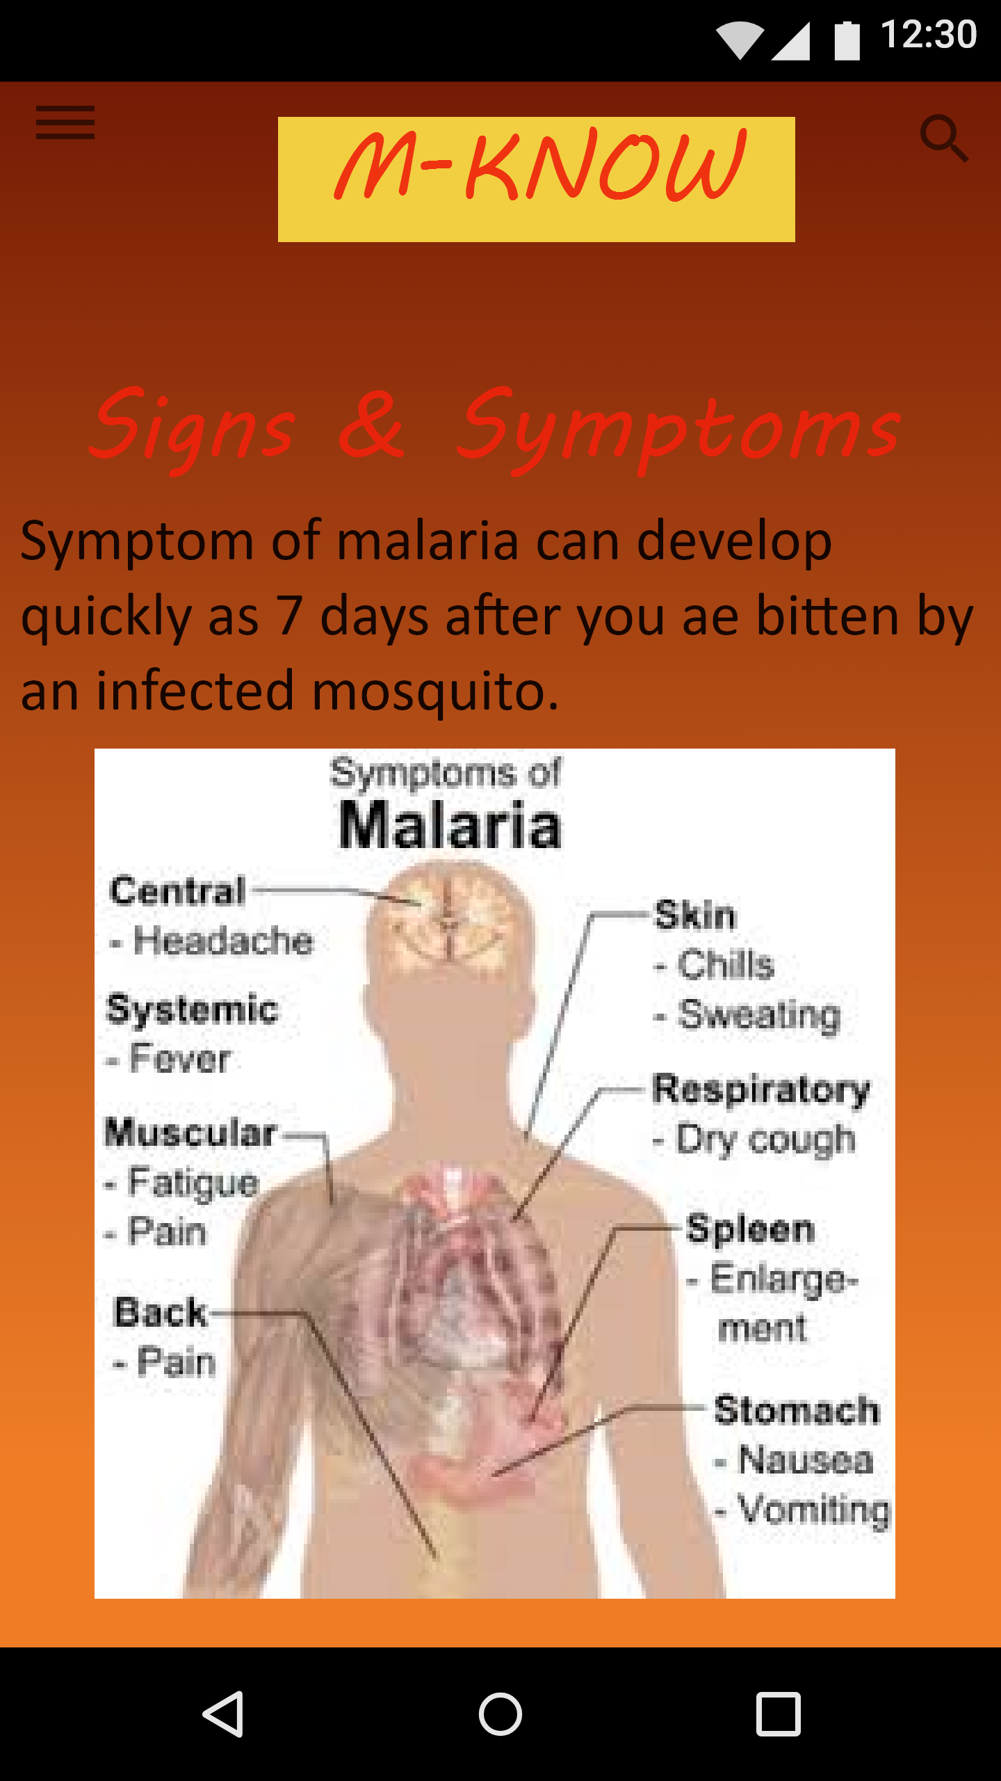
K-know Signs and symptoms
The screens show the signs and symptoms
of Malaria

Slide 10
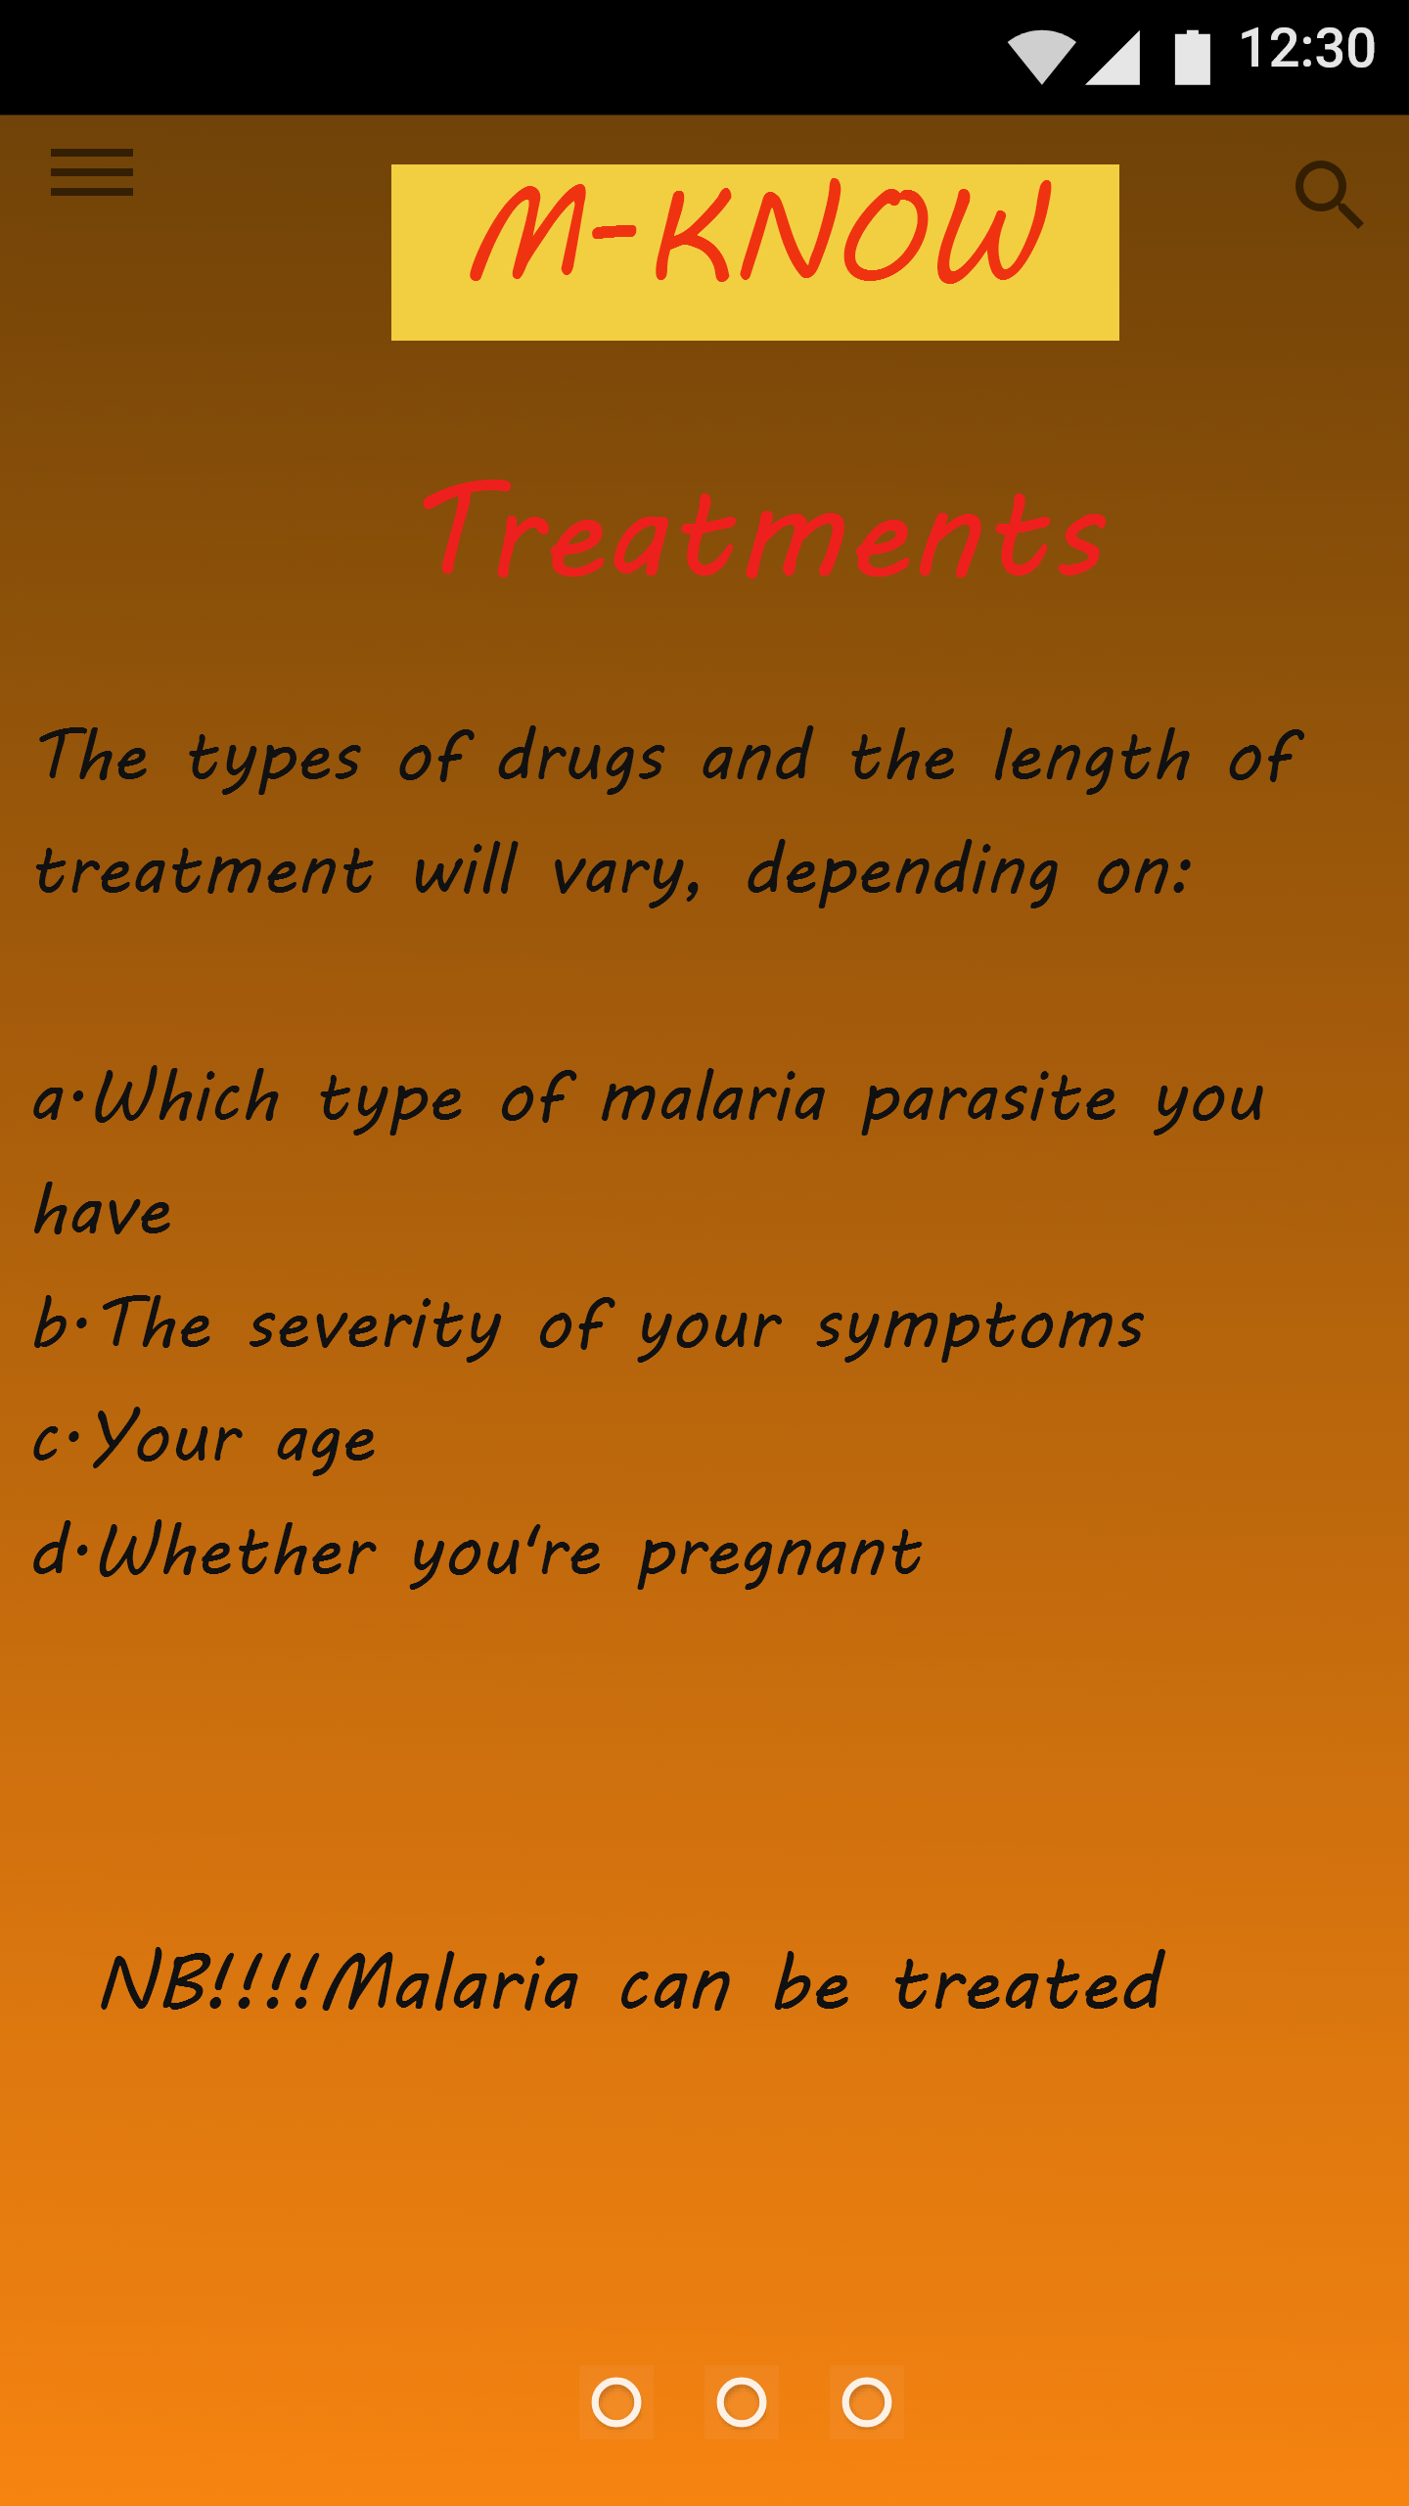
M-Know Treatment
The screen shows the treatments of malaria

Slide 11
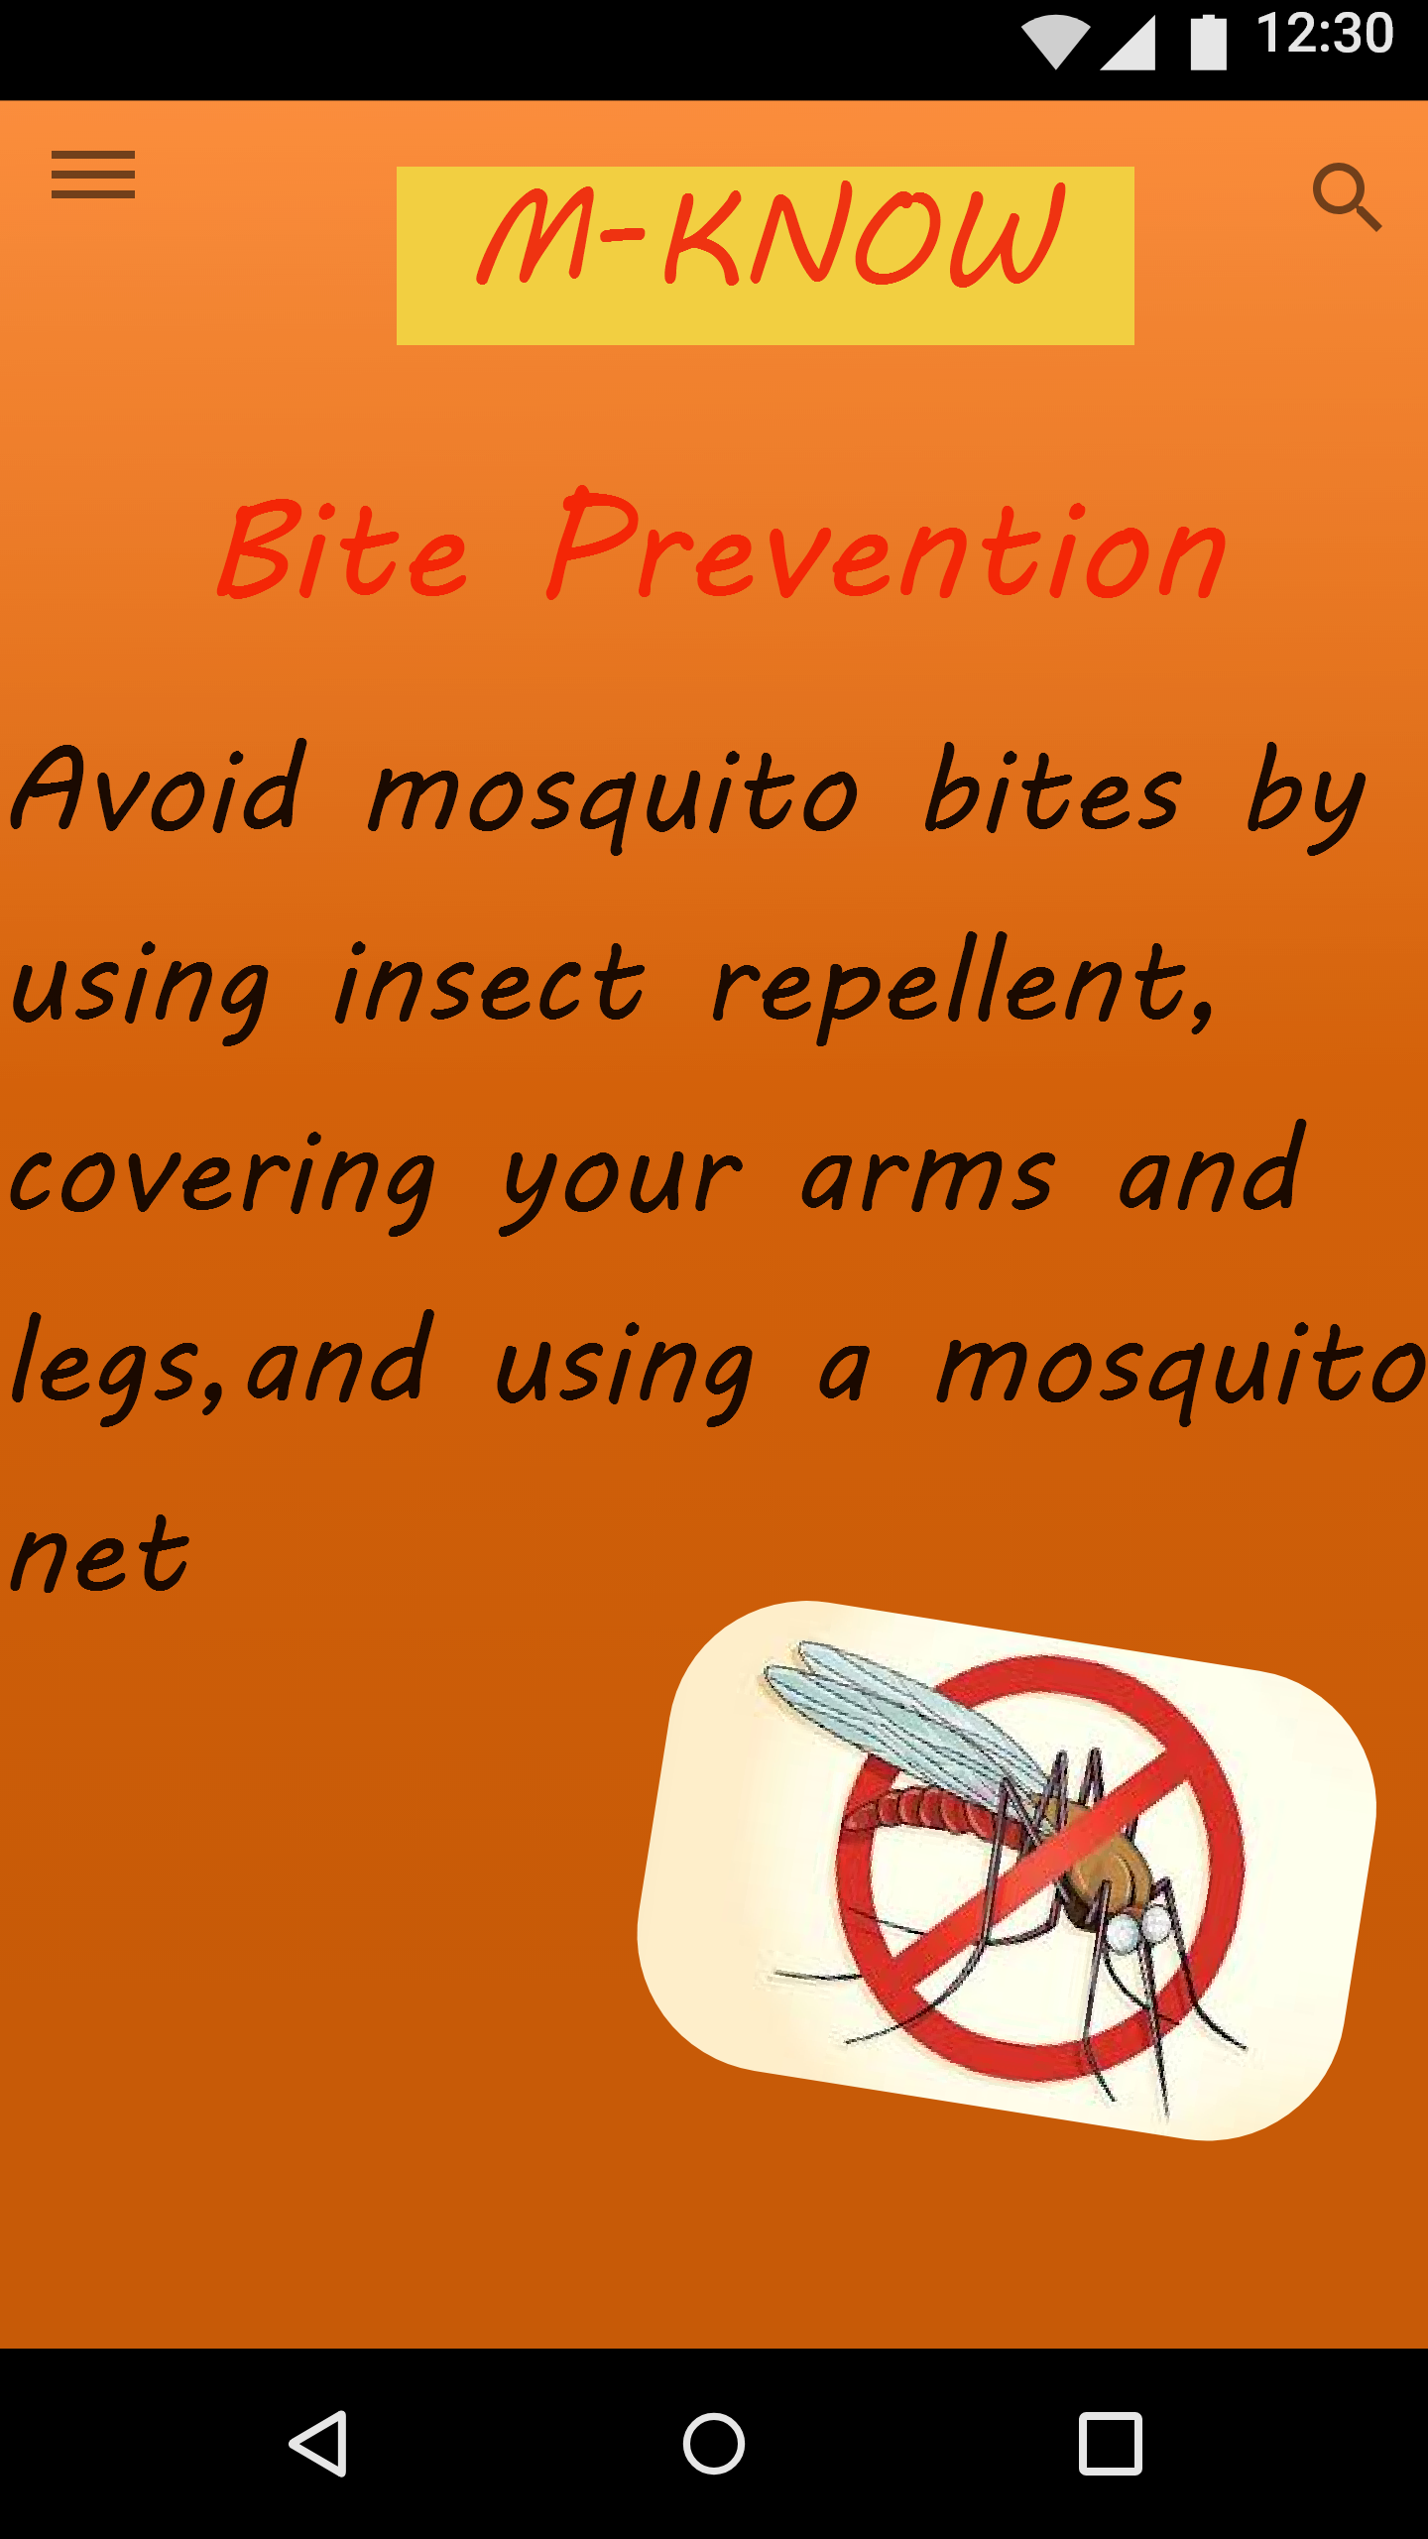
K-Know Prevention
The screen shows how to prevent malaria

Slide 12
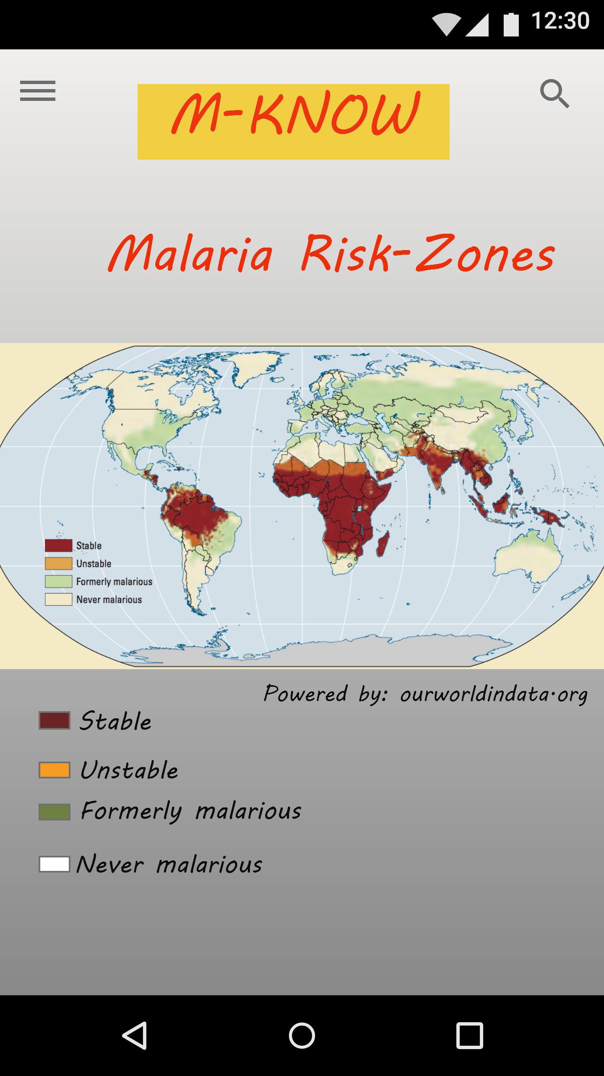
K-Know Malaria Risk Zone
The screen shows a map of which shows the high risk zones of Malaria

Slide 13
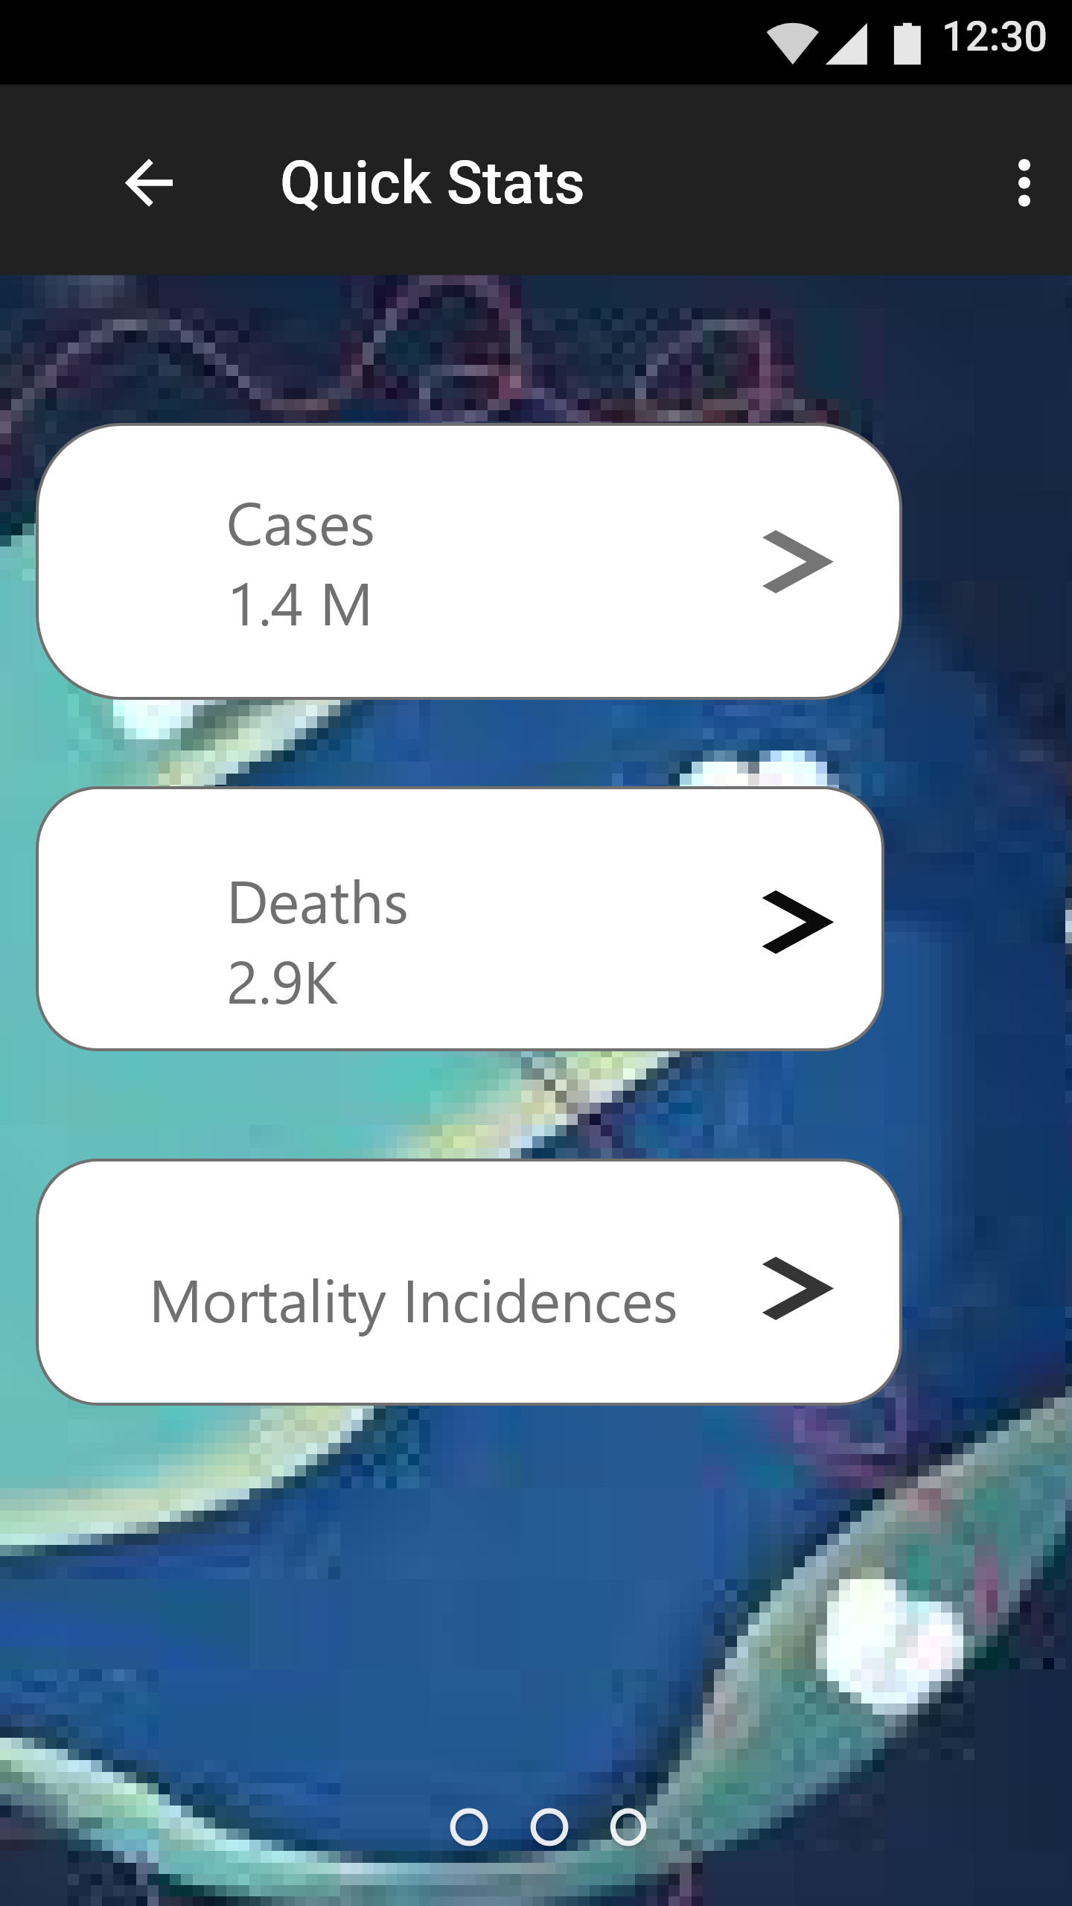
M-know Statistics
The screens show the statistics of malaria

Slide 14
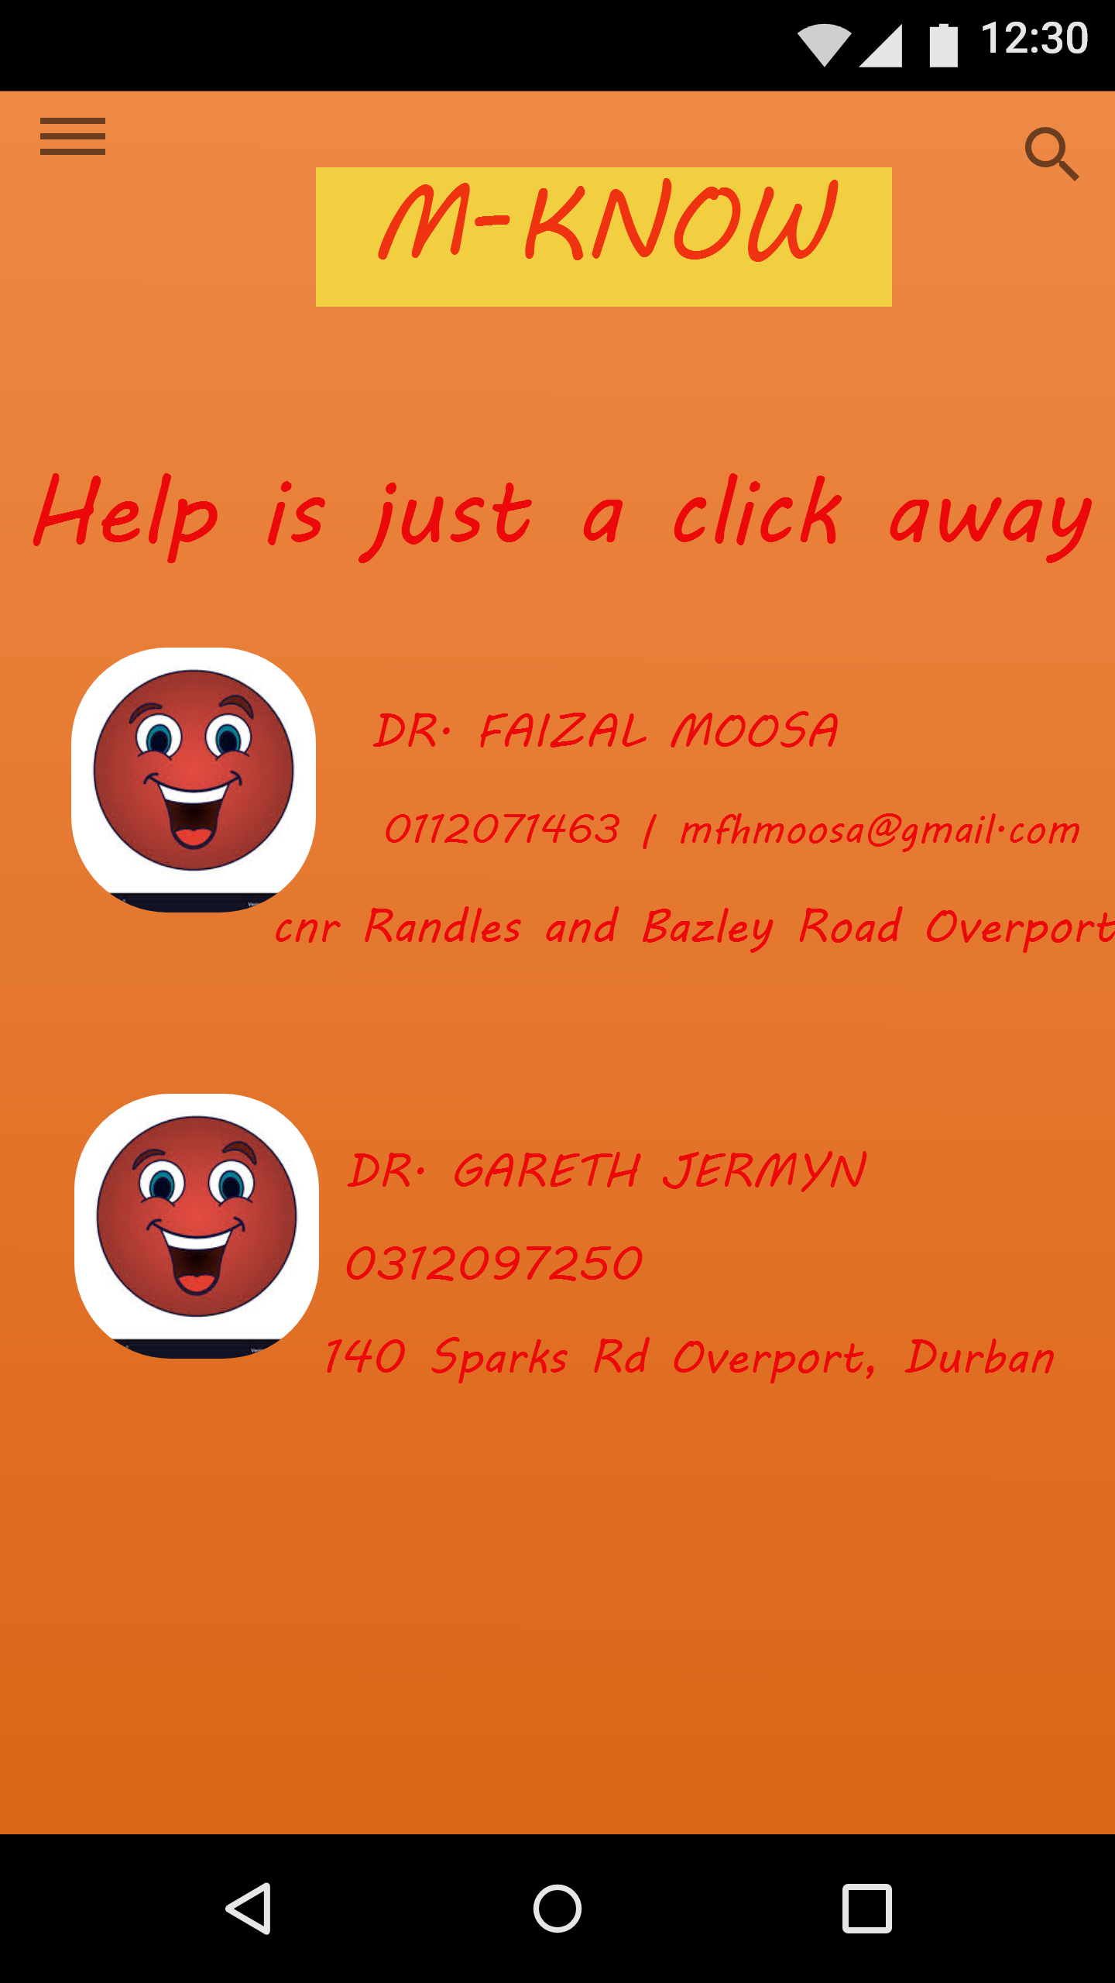
M-know Medical Practitioners
The screen shows the details of the medical practitioners

Slide 15
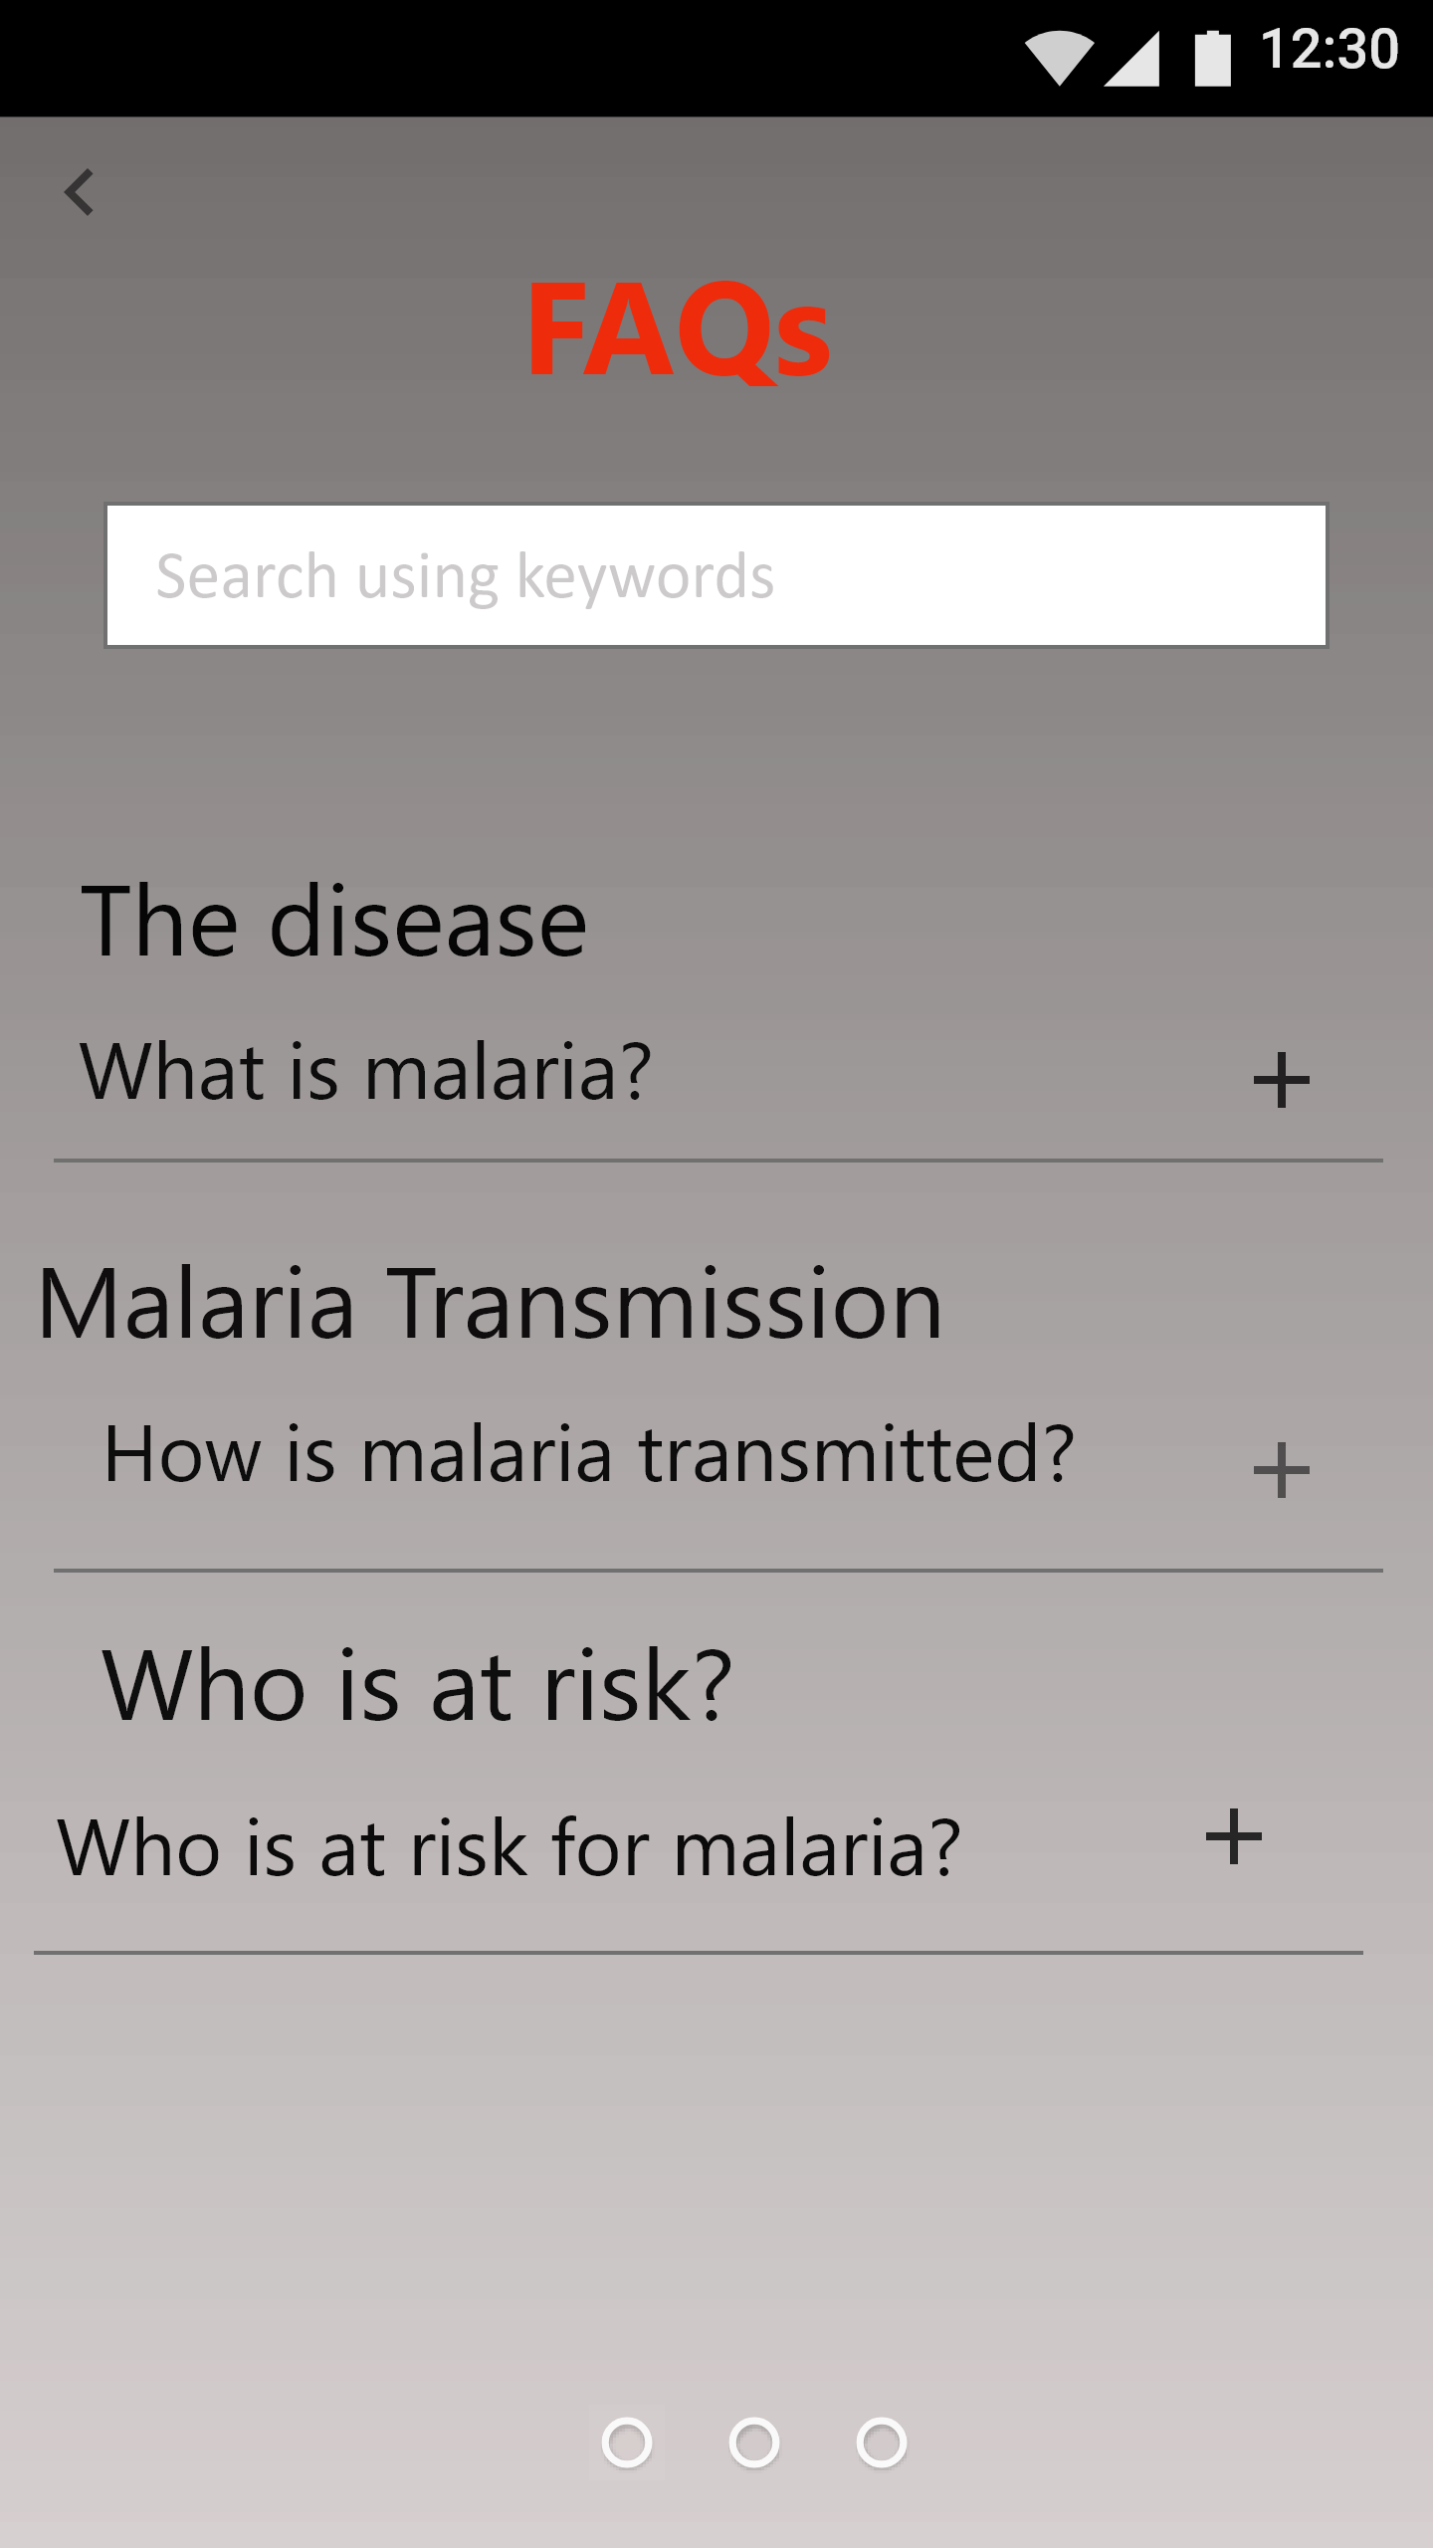
M-Know FAQ
The screen shows the list of frequently asked questions.
A user can also search for the questions using the search tab

Slide 16
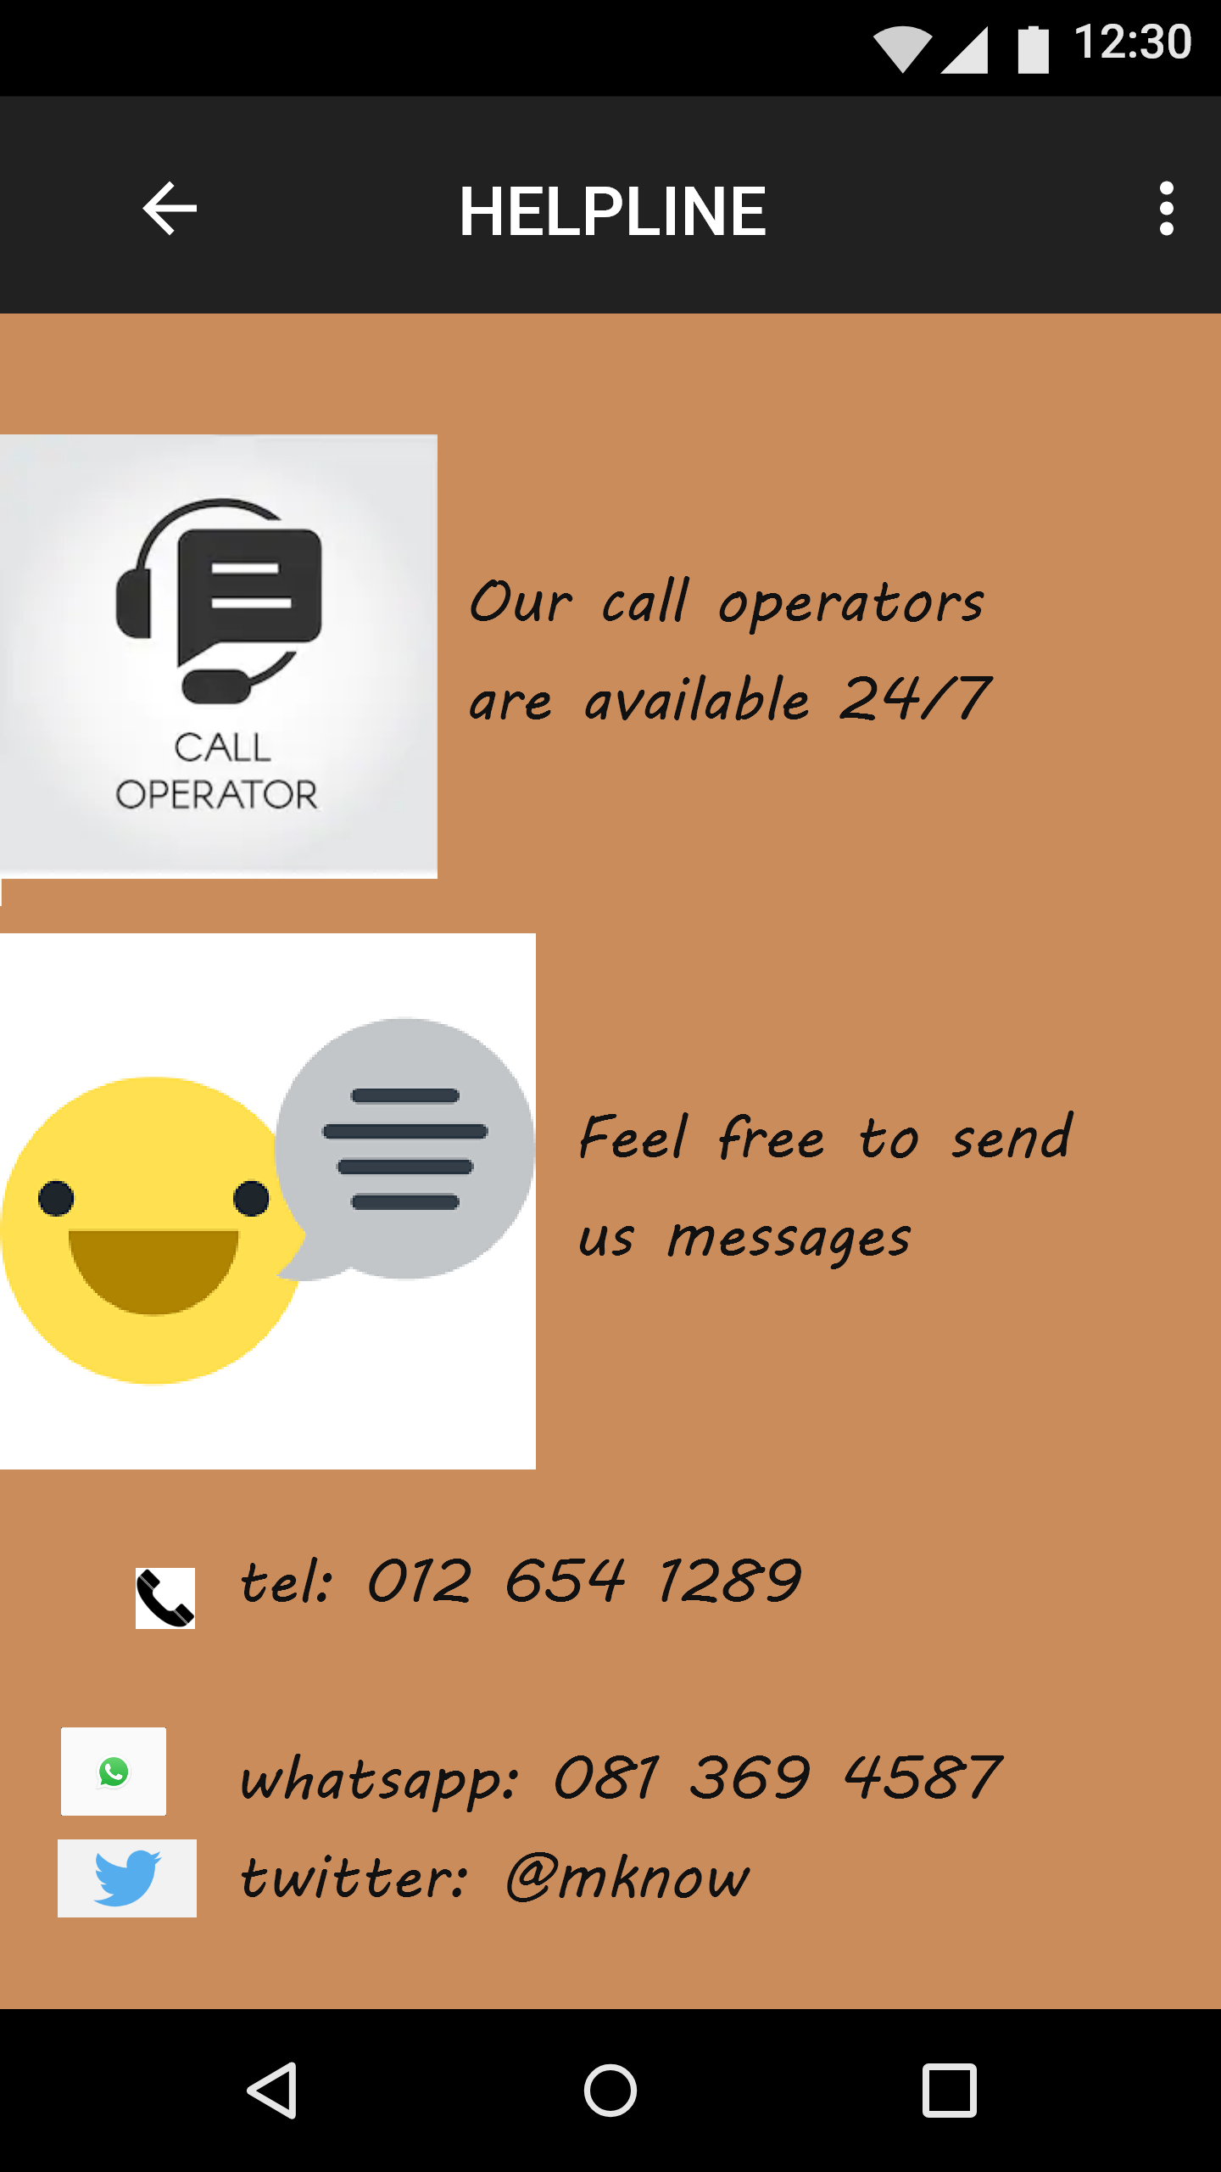
M-Know Helpline
The screen shows the helpline details and how different ways to contact M-know

Slide 17
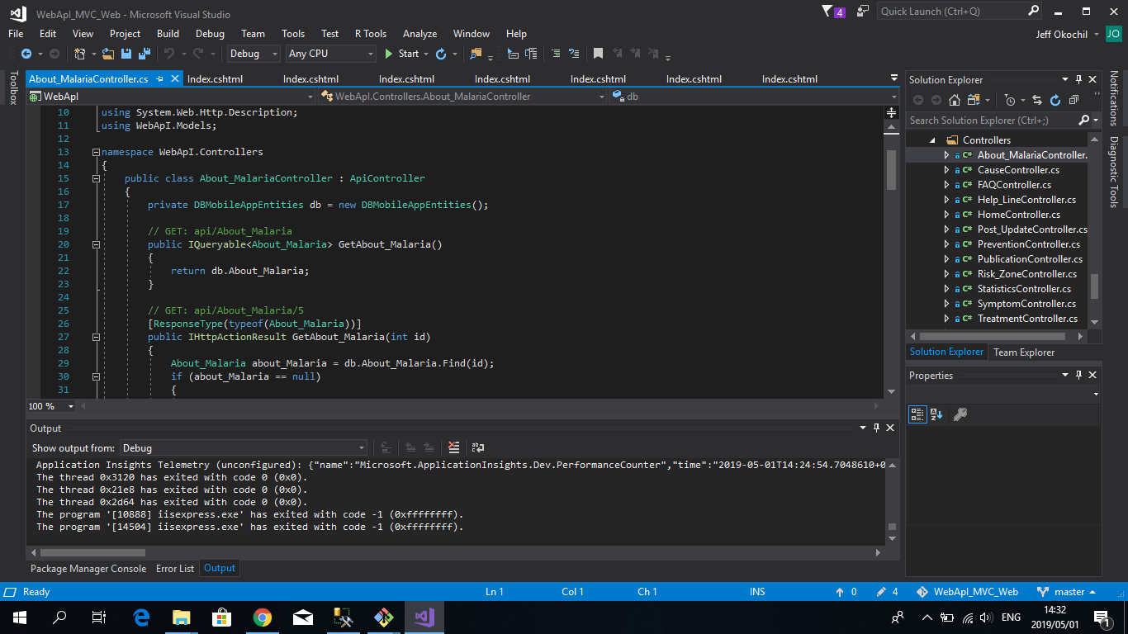
The API(Application Programming Interface)
The API allows applications to communicate with each other. The API is the messenger that delivers the requests to the provider that you are requesting from in this case requesting from the database and delivering feedback

Slide 18
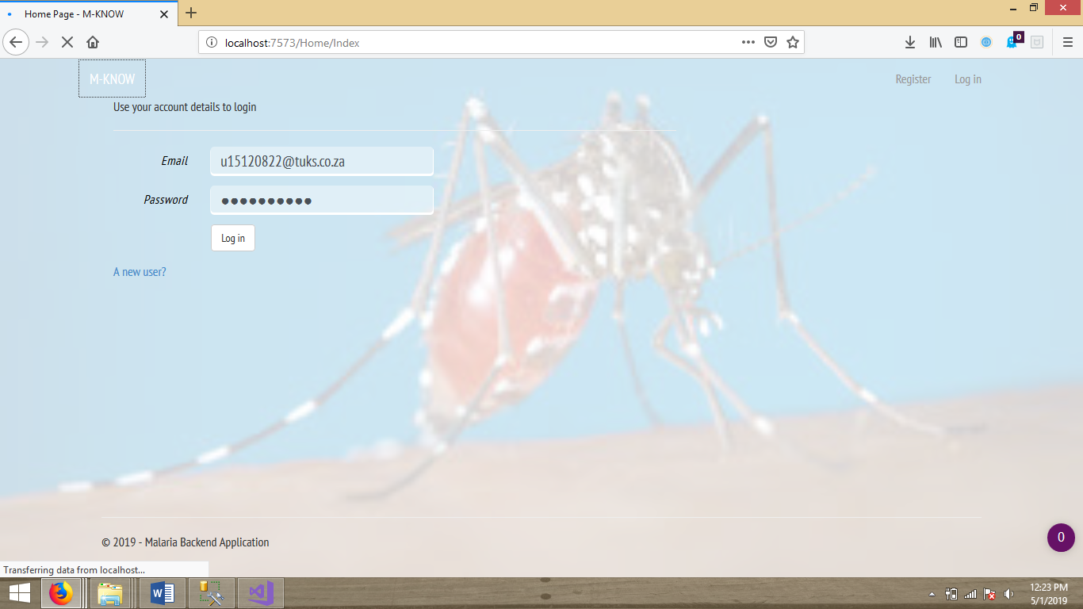
Administrative back-end
The system allows the authorized personnel to login to the system. The user is registered .They enters the details require, verification is done and the user logs in.

Slide 19
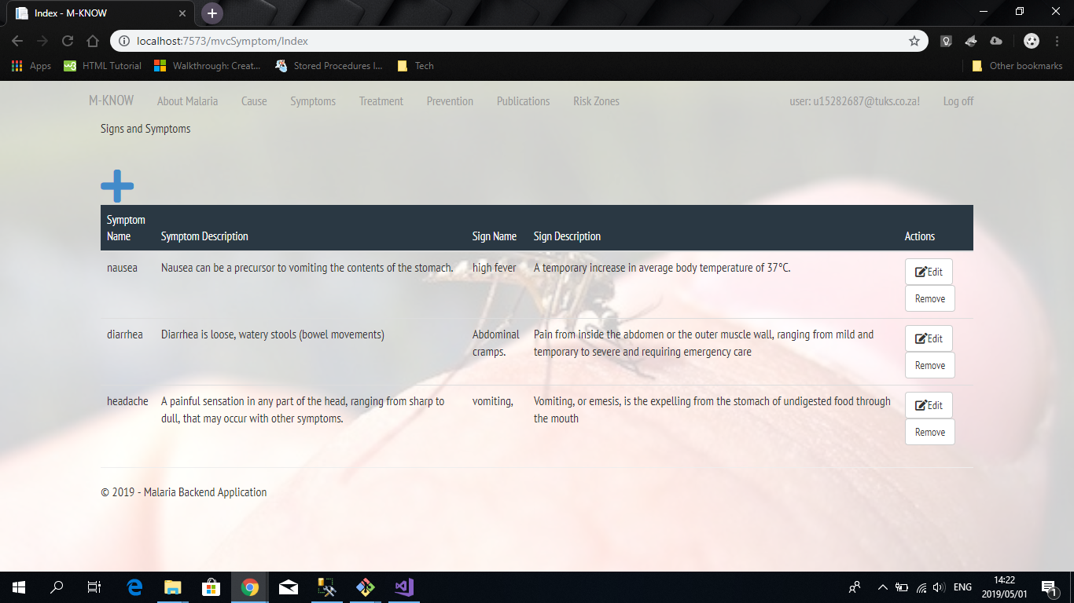
Administrative back-end(MVC)
The MVC(Model View Controller) is used to develop user interfaces that divides the interface into 3 interconnect parts.
This is our view representation of the model(structure and data management) and the controller(accepting input and converting it for the model or view)
There is also links to other views

Slide 20
Administrative back-end (Continued)
The user should be able to do the following CRUD functions
Add-used SQL INSERT(for the database)
Update-used SQL UPDATE
Delete –used SQL DELETE
All of this should be updated in the database and also the mobile app
This is also done for persistence storage

Slide 21

Thank you

